Slide 1
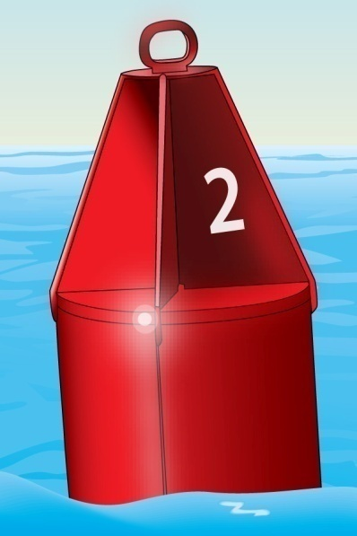
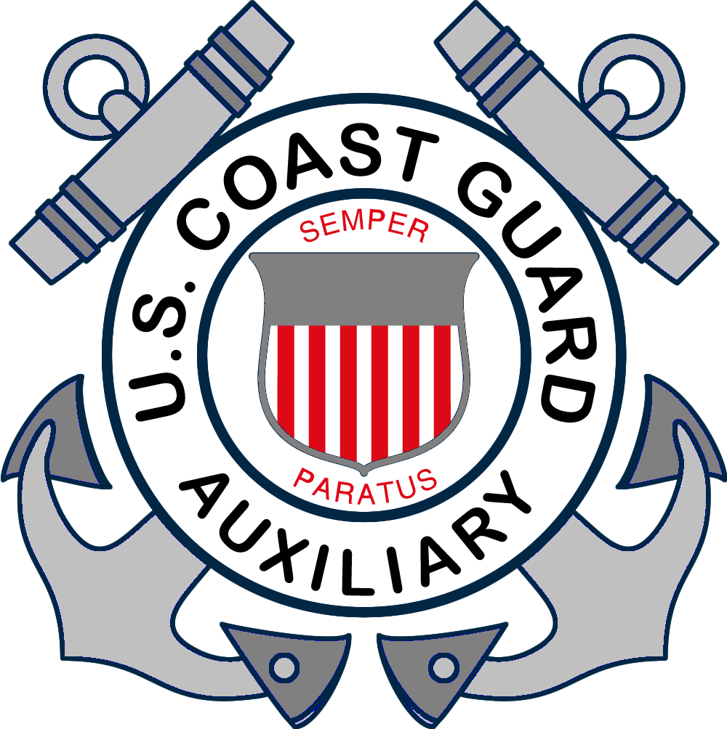
Chapter 3
Operating Your Boat…Safely

Slide 2
Key Topics
Navigation Rules
Navigation Lights
Night Navigation
Navigation Aids
Compasses and Charts
Sound Signals
Notes:
Instructor Notes:
Introduce these topics quickly as each will be detailed in later slides.
Instructor notes also reference Navrule numbers and in many cases, multiple Navrules apply to the situations depicted. It is not important for the student to know the Navrule specifically, but what it means in plain English. You are teaching the concepts – not the rules. Students can procure or download a copy of the Navrules from the Coast Guard Navcenter at https://www.navcen.uscg.gov/ if they want detailed information.

Slide 3
Key Topics
Casting Off and Docking
Anchoring
Jet-Propelled Watercraft Operation
Engine Cut-Off Switches
Changing Water Levels
Dams, Locks, and Bridges
Notes:
Instructor Notes:
Introduce these topics quickly as each will be detailed in later slides.

Slide 4
Objectives
You should be able to…
Give three major responsibilities of a vessel operator.
Explain what to do when encountering another vessel.
List the types of nighttime navigation lights and explain how to interpret them.
Explain what to do when encountering buoys and markers of the U.S. Aids to Navigation System.
Notes:
Instructor Notes:
Key objectives of Chapter three

Slide 5
Objectives
Use and understand sound signals.
Cast off and dock under different wind and current conditions.
Anchor a vessel correctly.
Operate a personal watercraft safely and courteously.
Notes:
Instructor Notes:
Key objectives of Chapter three

Slide 6
Objectives
Explain how an engine cut-off switch works.
Explain how to use a compass and read a nautical chart.
Explain what to do when encountering various hazards—dams, locks, bridges, and changing water levels.
Notes:
Instructor Notes:
Key objectives of Chapter three
Compass and Nautical charts not covered in detail – only introduced in this course.

Slide 7
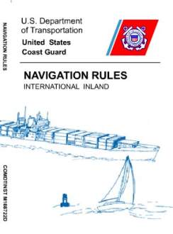
Navigation Rules
Three basic rules of navigation:
Practice good seamanship.
Keep a proper lookout.
Maintain a safe speed.
Departure from the rules is ok if necessary to avoid collision.
Q-39
Q-41
Notes:
Instructor Notes:
Test question 39. What should a vessel operator do to keep a proper lookout? Answer- Watch for navigational hazards.
Test question 41. Why should a vessel operator keep a proper lookout? Answer – To avoid collisions.
Failure to do any of these three bullet points on the slide are the primary causes of boating accidents.
Navrules
Can be downloaded from the Coast Guard Navigation Center at https://www.navcen.uscg.gov/
Also available on the Coast Guard app in IOS and Android
Seamanship is rule 2
Lookout is rule 5
Speed is rule 6

Slide 8
Navigation Rules
Rules of Responsibility
All boaters are responsible for preventing collisions.
If you must make a departure from the navigation rules, make this decision based on:
All the dangers of navigation
The risk of a collision
Any special conditions
Q-22
Notes:
Instructor Notes:
Test question 22. When two vessels are operating in the same general area, who is responsible for avoiding a collision? Answer – The operator of BOTH vessels.
Do whatever you need to do to avoid collision. Everyone needs to lookout for the other guy and be prepared to take evasive action, change course, or stop to prevent a collision. This is Rule 2

Slide 9
Navigation Rules
Rendering Assistance
Required to stop and render assistance to vessels in distress unless doing so would endanger your vessel, you, your crew, or passengers.

Slide 10
Navigation Rules
The action a vessel operator should take when encountering another vessel depends on:
How the two vessels are propelled
How the two vessels are approaching one another
Q-25
Notes:
Instructor Notes:
Test question 25. When is a sailboat under sail the GIVE WAY vessel when encountering a power driven vessel? Answer – When the sailboat is OVERTAKING the power driven vessel.
Meeting, Crossing, Overtaking are three situations where boater need to know what actions they are required to perform.
Two power boats – depends on position and direction and speed of travel
Power and Sail – power give way - sail is stand on EXCEPT when overtaking. In every case, the overtaking vessel is the give way vessel.
Two sail boats – With the wind on the same side, the sailboat on the starboard tack stands on. On different sides, the boat to the downwind side (leeward) is the stand on vessel.

Slide 11
Navigation Rules
Always give way to:
Anchored or disabled vessels
Vessels restricted in their ability to maneuver
Vessels constrained by their draft
Commercial fishing vessels

Slide 12
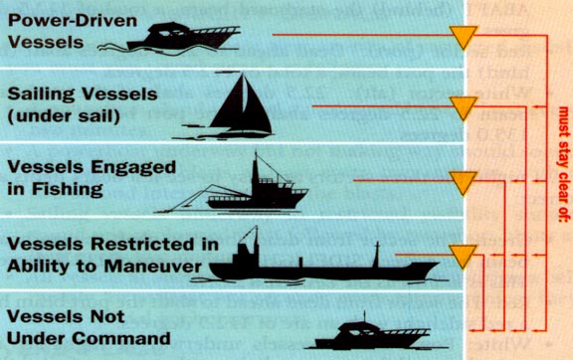
Hierarchy of Maneuverability
Notes:
Instructor Notes: Ask if the students can guess if there is a higher category than those shown on the slide. The higher category of boats must stay clear of those below it.
A sailboat under power is considered a Powerboat.
One additional category not shown is the seaplane at the very top of the list

Slide 13
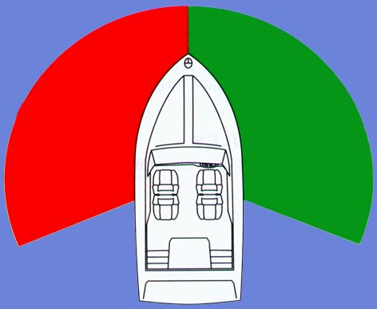
Sectors
White Sector
112.5º
112.5º
Red
Sector
Green
Sector
White Sector
135°
Notes:
This slide sets up the basis for the Navrules as they pertain to stand on versus give way and identifies direction of vessels at night. Spend enough time so the students completely understand this slide and it’s importance.
Explain significance of colors – red equals danger, stop, don’t go here. Green means go, safe to proceed, etc.
Ask if any student can identify why most boats pilots position is on starboard side. Starboard side pilot placement provides unrestricted visibility to your “danger zone.”
Explain “danger zone” is to their right from straight ahead to 112.5 degrees. Any other vessel appearing in this area – you are give way vessel. A vessel appearing anywhere else (in red or white sectors) you are stand on vessel.

Slide 14
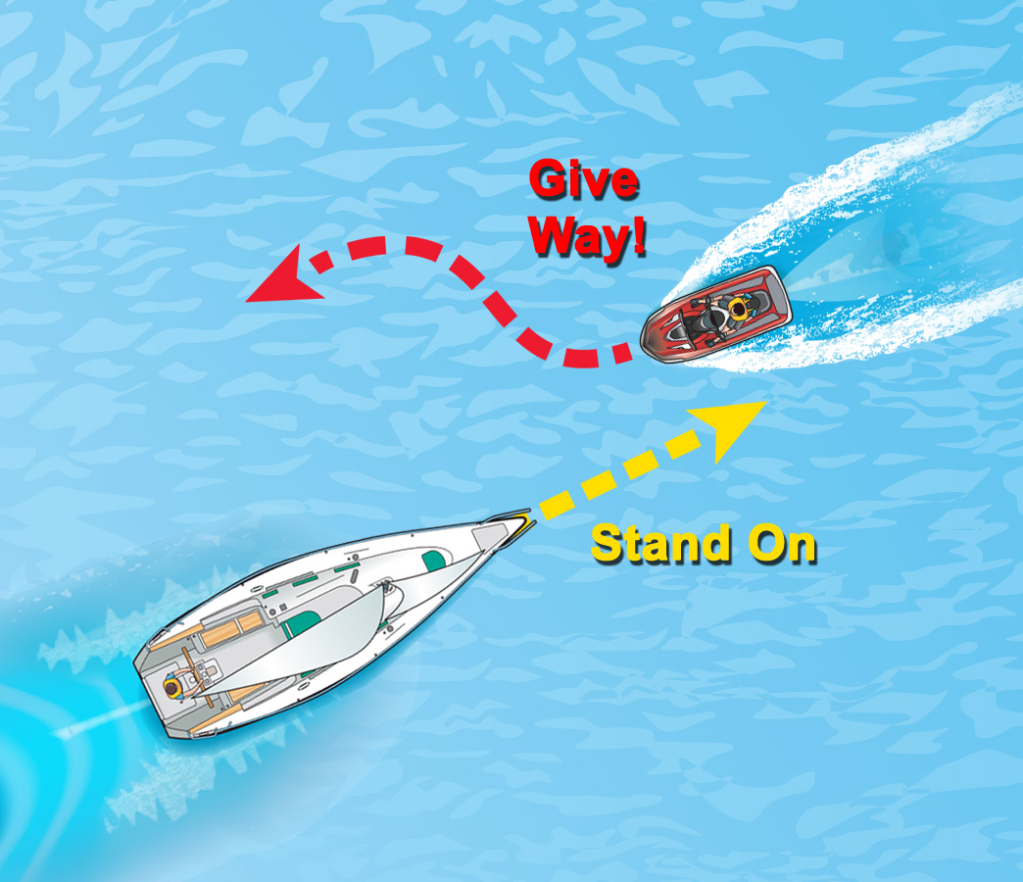
Navigation Rules
Two terms help explain what to do when encountering other vessels.
Give-Way Vessel
Stand-On Vessel
Q-46
Notes:
Instructor Notes:
Test question 46. What should the operators of a PWC and a motorboat do when approaching head-on? Answer – Both vessels should turn to starboard (right). This is preferred and the correct answer to the test question, but the Navrules allow passing on either side when there are no other obstructions.
Give Way Vessel must stay out of the way of other boats. Slowing down and changing course noticeably are visual signs to other boats that you are altering course to avoid collision.
Stand on Vessel must maintain course and speed and act in a predictable manner so the give way boats can decide what maneuver they need to make to stay clear and avoid collision.
If the give way vessel does not take appropriate action and a risk of collision exists, then you as the stand on vessel must break the rule and change speed or course to avoid collision even though it breaks the rule. Avoid collision at all costs – even running aground is preferable to collision! This is Rule 2 of the Navrules.
Discuss: that a sailboat with it’s engine running, either with or without sails raised, is considered by the Nerveless to be a power-driven vessel

Slide 15
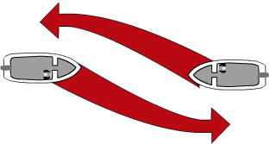
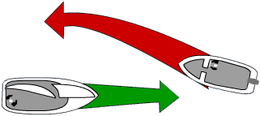
Meeting Head-On
Power
Give Way!
Power
Give Way!
Power
Give Way!
Sail
Stand on!
Notes:
Ask: If two powerboats are meeting head on, which one is the give way vessel? If one is a sailboat, which gives way?

Slide 16
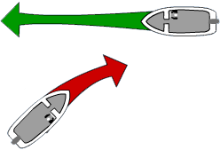
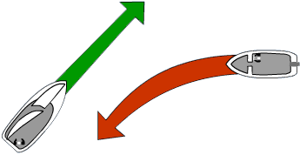
Crossing Situations
Power boat
Stand on
Power boat
Give way
Power boat
Give way
Sail boat
Stand on
Notes:
Instructor Notes:
Before animating slide:
Ask: If two powerboats are crossing, which one gives way? If one is a sailboat, which gives way?

Slide 17
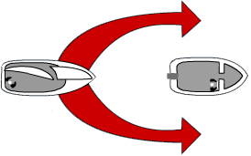
Overtaking
“A”
Give way
“B” Stand on
Notes:
Before animating slide:
Ask: Who gives way when one boat overtakes another? If one is a sailboat, which gives way?

Slide 18
Narrow Channels
When operating in a narrow channel keep as close to the outer limit of the channel on your starboard side as is safe and practical.

Slide 19
Navigation Rules
Navigation During Restricted Visibility
Keep a safe speed for the conditions.
Slow down to avoid a collision.
Reduce speed to idle speed if necessary.
Q-23
Q-45
Notes:
Instructor Notes:
Test question 23. How do you know when you are operating your vessel at a safe speed? Answer – You have enough time to avoid a collision.
Test question 45. What determines if a speed is safe for your boat? Answer – Visibility conditions.
Safe speed is Rule 6. Excessive speed is high on the list of the things that are contributing factors to accidents and if one occurs, a slower speed impact causes less damage to the vessel and occupants than one at higher speed. Slow down when visibility is limited (darkness, fog, etc.) and in areas without clear sight lines.

Slide 20
Night Navigation
Boats must use navigation lights:
From sunset to sunrise
When visibility is restricted
Lights tell you:
If the other vessel is power-driven or under sail
Which way the other vessel is going
Follow the same navigational rules used in the daytime.
Q-47
Q-49
Notes:
Instructor Notes:
Test question 47. When must navigation lights be displayed? Answer – From sunset to sunrise and when visibility is restricted. (Some states may have more restrictive rules and you must differentiate between the federal requirements for this test question and any state differences that may be covered in state supplements)
Test question 49. Visibility is restricted due to fog. What should the vessel operator do to avoid the risk of collision? Answer – Reduce speed to the minimum necessary to stay on course.
This is also Rule 6
State laws may vary when Navigation lights must be illuminated. Know your state laws and quote them here. Proactively, turn them on at the first sign that visibility is deteriorating even if not legally required.
Different light configurations are shown in the text book. Point out the various combinations of red, green, and white lights and what colors you see give you clues about the direction and possibly the type of vessel about to be encountered.
Don’t forget it is very easy to confuse the lights of boats on the water with background lights of things on shore. Familiarity with the area during daylight hours in good visibility helps establish a point of reference when the same area is transited in periods of darkness or reduced visibility. Slow down and come to a stop if you are not certain about what lights you see are telling you so you can take appropriate actions.

Slide 21
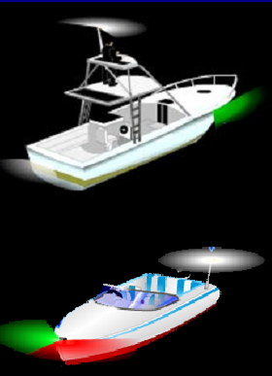
Night Lights
Side lights
Stern lights
Masthead light
All round
white light
Notes:
Instructor Notes:
Before animating slide:
Ask: Why do boats have lights?
To identify the type of boat
To identify which boat is stand on and give way.
Ask: What are the colors and names of the lights you need?
Discuss arc of visibility for each.
Point out that sailboats under sail do not display a masthead light.
Side lights
Red and green seen at front of boat
Stern lights
White seen at rear of boat
Masthead light
White seen from forward and sides
All round white light
Seen from all directions

Slide 22
Night Navigation
Towing Lights
When commercial vessels are towing, they display one or more yellow lights in place of a sternlight.
Notes:
Instructor Notes:
This is Rule 24. Yellow light is the universal signal for towing behind or pushing ahead. Different tow vessel light configurations are for different towing situations and lengths of tows. Just like the law of Gross Tonnage (not in the Navrules anywhere) if it has more lights than you do, stay out of the way.
Emphasize that there may be many yards between the vessel towing and being towed and the danger of crossing between the two.
Point out the two white masthead lights, indicating a vessel towing.

Slide 23
Lights On Tows
Towing Lights
Note: unlit space of several hundred yards between the lights on the bow and stern
Notes:
Emphasize that there may be many yards between the vessel towing and being towed and the danger of crossing between the two.
Point out the two white masthead lights, indicating a vessel towing.

Slide 24
U.S. Aids to Navigation System
Lateral Markers
Can Buoys: Green With Odd Numbers
Nun Buoys: Red With Even Numbers
Q-24
Notes:
Instructor Notes:
Test question 24. What is the main purpose of the lateral system of red and green buoys and markers? Answer – To mark the edges of safe water areas.
Greens will always be odd number and reds will always be even numbered. In reduced visibility or at a distance, you can tell the shape of the ATON before you can tell the color and you can tell the color before you can read the number. Note that greens are shaped like a can and reds are shaped like a Nun’s cap, therefore the names can and nun buoys.

Slide 25
U.S. Aids to Navigation System
Lighted Buoys
Green Colors and Lights
Red Colors and Lights
Notes:
Instructor Notes:
Light will indicate color of the marker for navigational reference. All lighted buoys will have different flashing patterns which correspond to the symbol on the chart. This allows differentiation of each specific ATON at night.

Slide 26
U.S. Aids to Navigation System
Daymarks (on a fixed post or piling)
Reflective Green, Odd Numbers
Reflective Red, Even Numbers
Notes:
Instructor Notes:
All ATONS are reflective of light and of radar if your boat is equipped with radar. ATONS such as these are on fixed posts or pilings which indicate that they are embedded in the bottom and it is shallow in the vicinity of the ATON. Give any fixed marker a wide berth and don’t get too close.

Slide 27
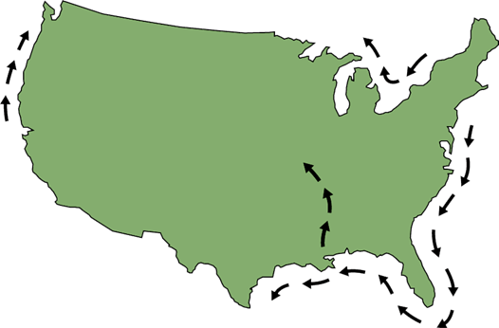
U.S. Aids to Navigation System
“Red Right Returning”
When you go
clockwise around the
U.S. you are
RETURNING from the sea

Slide 28
U.S. Aids to Navigation System
“Red Right Returning”
Notes:
Instructor Notes:
When returning from sea or going upstream in a river or creek, when you are going in the direction from the sea to the origination of the waterway upstream, keep the reds on the right. Conversely, the greens will be on the left. When going downstream back toward the sea and away from the origin of the waterway, you would keep the greens on the right and reds on the left. Remember this by the mnemonic “Red, Right, Returning”.

Slide 29
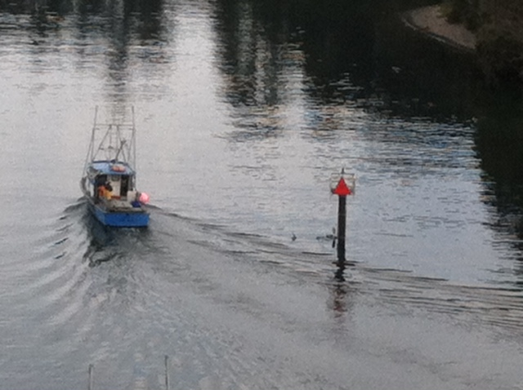
U.S. Aids to Navigation System
“Red Right Returning”

Slide 30
U.S. Aids to Navigation System
Lateral Markers—(ICW)
Keep on your starboard (right) side
Keep on your port (left) side
Notes:
Instructor Notes:
When in the Intercoastal Waterway, the red, right, returning follows a clockwise direction around the US. If you start in Norfolk VA and are going to Miami on the east coast of the US, then keep the reds on the right.
However, the ICW intersects various inlets from the ocean and there is a system to differentiate between ATONs that mark the safe water for an inlet and the safe water for the ICW. This special marking is yellow squares (treat it as a green marker) or a yellow triangle (treat it as a red). This indicates you are following the ICW and then you can correlate with your charts the numbers on the ATON to confirm where you are. Notice that the fixed ATONS in this illustration are green squares and red triangles which also correspond to the yellow squares and yellow triangles.
However, ANYWHERE the ICW intersects an inlet, caution MUST be taken to follow the yellow squares or yellow triangles. Sometimes, a single ATON will serve as a marker for both the ICW and the inlet and NOT ALWAYS are they on the same color ATON you expect them to be on. An example is a green ATON marking the right side of an inlet from the ocean, but containing a yellow triangle. This means keep it to the right if coming in from the ocean, and also to keep it to your right and treat it as a red marker if you are traveling southbound on the east coast of the US. If you treated it as a yellow square which you would expect to see on a green painted ATON, you would pass on the wrong side and possibly run aground.

Slide 31
U.S. Aids to Navigation System
Western Rivers System Marker
Indicates 73.5 miles from the river’s mouth
Notes:
Instructor Notes:
These are statute miles in the inland rivers. Charts reference the river miles and often marinas and other services reference the mile marker for their locations. It works in a similar fashion to highways and interstates.

Slide 32
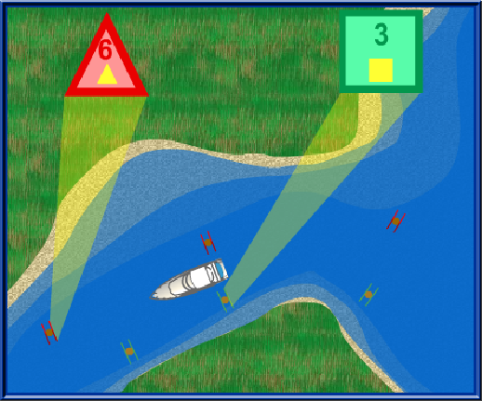
U.S. Aids to Navigation System
ICW Symbols
Notes:
Be especially careful when following the ICW near inlets as sometimes the ICW yellow markings may be on a Navaid marking the inlet and may or may not be on a color or shape marker as you expect. It is possible to have a yellow triangle on a green inlet marker and a yellow square on a red inlet marker. This apparent conflict only occurs near inlets where the ICW intersects.
Follow the proper markings for the route you intend to follow. If you are following the ICW and you wish to continue to follow it past the inlet, only pay attention to the yellow marks and disregard the shape or color of buoy or daymark they appear on.
Reconcile your position with a chart to insure safe passage.

Slide 33
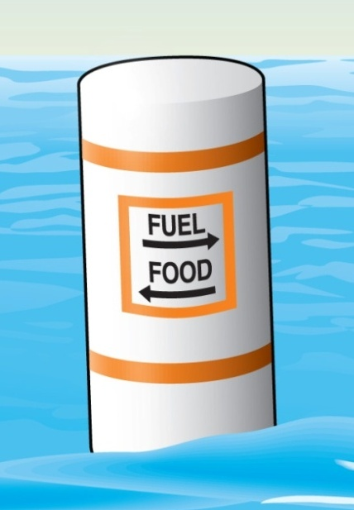
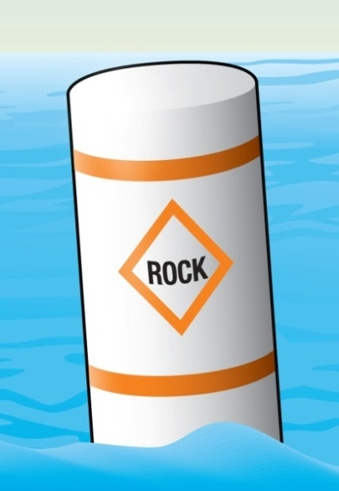
U.S. Aids to Navigation System
Non-Lateral Markers
Information
Danger Area
Notes:
Instructor Notes:
Square box indicates information. It is not regulatory or restrictive.
Triangle indicates danger in the area.

Slide 34
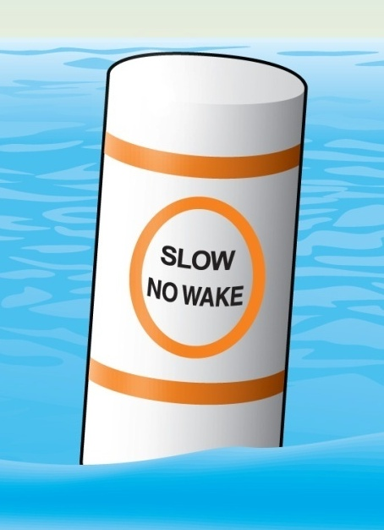
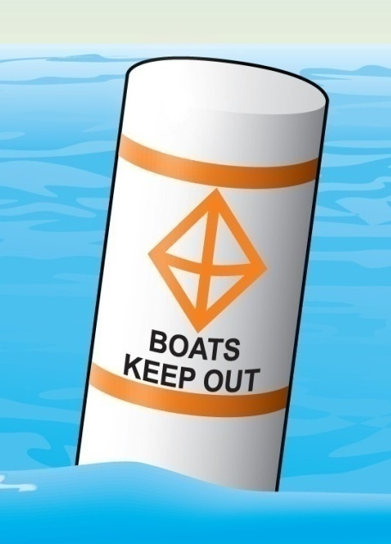
U.S. Aids to Navigation System
Non-Lateral Markers
Controlled Area
Exclusion Area
Q-27
Notes:
Instructor Notes:
Test question 27. What is indicated if you see a white marker that has an orange crossed diamond and black lettering on it? Answer – Exclusion or keep out area such as a dam.
A controlled area has restrictions or limitations. No wake means just that – slow enough that your boat does not produce a wake from the bow. You may need to place the gear shift in neutral and shift in and out of gear to maintain slow enough speed if you have a higher horsepower boat. Note that in windy weather or conditions with strong current, you must maintain enough power for directional control even if it causes a small wake. Do not loose steering control regardless of the restriction on wake.
The exclusion means just that – do not go here!

Slide 35
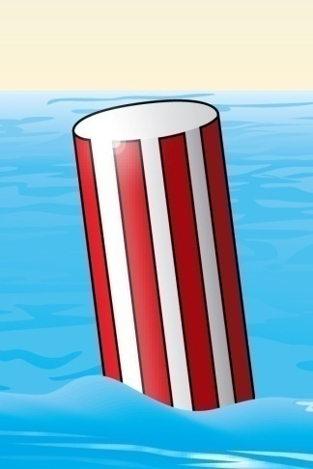
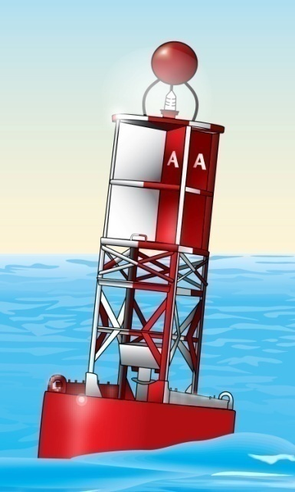
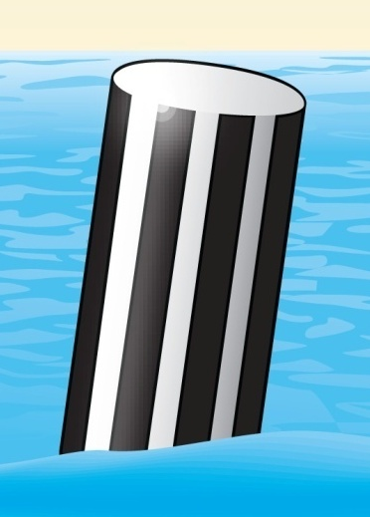
U.S. Aids to Navigation System
Other Non-Lateral Markers
Safe Water Markers
Inland Waters Obstruction Marker
Notes:
Instructor Notes:
Sometimes referred as the “sea buoy” which means that now you have reached the end of the marked channel and the water is safe for navigation all around. If coming into a channel from sea, plot this buoy as your point to begin your course in the marked waterway. Do not plot your course DIRECTLTY on the ATON, but a few yards away is OK.
The black stripe buoy is used on inland lakes and rivers to indicate the “end of the reef” which means DO NOT PASS BETWEEN THIS MARKER AND THE NEAREST SHORE! Often there are other intermediate markers on fixed poles to indicate the line of obstruction. Give these areas a wide berth as they are often on fixed poles which means shallow water around them.

Slide 36
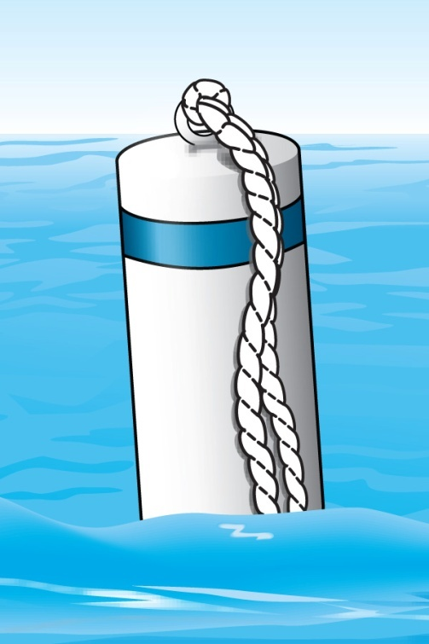
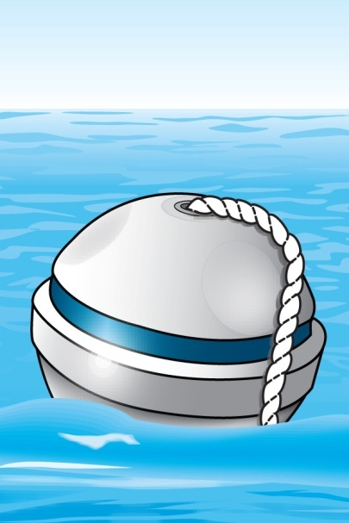
U.S. Aids to Navigation System
Other Non-Lateral Markers
Mooring Buoys
Notes:
Instructor Notes:
These are designed for boaters to tie up without the need to deploy an anchor. Often, they are laid out in an efficient pattern that allows many other boats to use a designated anchorage and have sufficient swing room as wind or current conditions change. Every part of the buoy that touches the water will be slimy so be prepared with gloves as you pick up the pendant to attach a short line from your boat to the pendant. The line is anchored to the bottom securely. Look at other boats in the anchorage to see how much line they have out. If you match that length, the entire anchorage will swing in unison and no one will tangle up with another boat (at least in theory).

Slide 37
U.S. Aids to Navigation System
Junction Buoys
A
B
Notes:
Junction buoys indicates a split in a channel. The upper band tells the boater which channel is the preferred channel. The preferred channel is the deepest and widest channel. A boater may need to go into the non-preferred channel to get to their dock, local restaurant, fuel, etc.

Slide 38
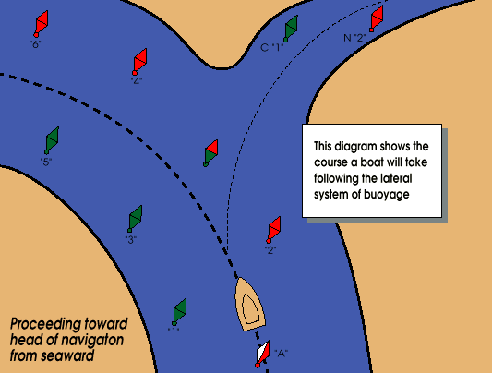
U.S. Aids to Navigation System
Junction Buoys:
Notes:
This boat approaches the channel and sees a junction buoy with a red top band. Which course will the boat follow to stay in the preferred channel?

Slide 39
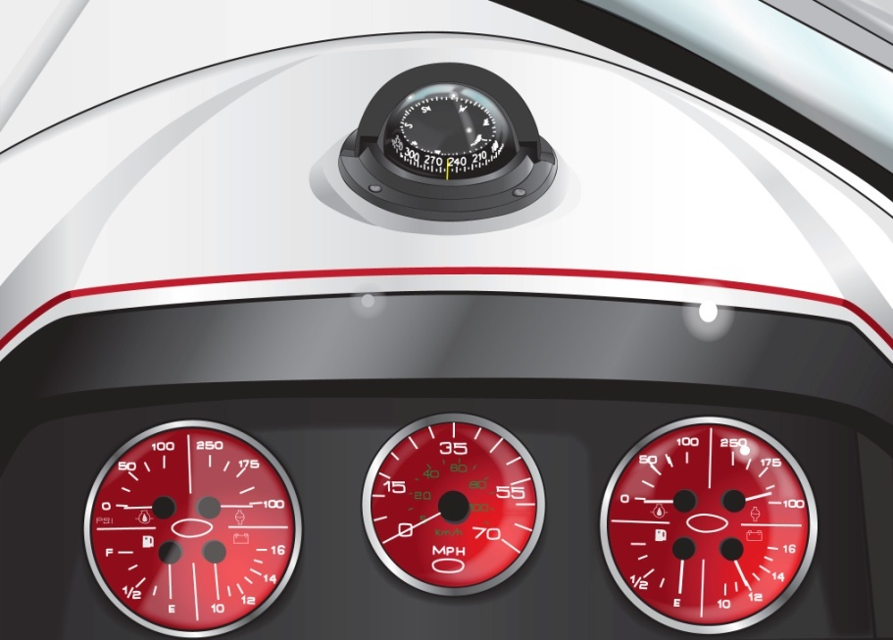
Compasses and Charts
Steering Compass
Can be invaluable in bad weather at night.
Mount it away from iron, magnets, and electrical wiring and equipment.
Notes:
Instructor Notes:
Correlate your direction as read on the compass with a chart and along with ATON sightings and a chart, you can quickly find where you are in relation to where you think you are. Electric current and magnets affect the ability of the compass to show your current heading. When installing a new compass, engage each electrical component while watching the compass to see if turning on that electrical load has any affect on the compass. Simply rerouting any interfering equipment or power runs to the equipment will solve most issues

Slide 40
Compasses and Charts
Nautical Charts
In bays or large lakes, charts give:
Water depths
Locations of channels, sand bars, rocks, and vegetation
Most direct course possible
Notes:
Instructor Notes:
Be careful not to turn this into a navigation class. You may wish to mention the Weekend Navigator or other Auxiliary navigation products as an additional class for those who are interested. You may wish to pull out a local chart and show a few features and especially any areas of concern or challenging areas.

Slide 41
Compasses and Charts
Notes:
Instructor Notes:
Briefly explain the symbols on the chart above. Cover the RG “A” and what that means with primary and secondary channels. Also cover the flashing light characteristics and the tank light on shore.

Slide 42
Sound Signals
Sound signals use short and prolonged blasts. They must be audible for at least one-half mile.
Short blast—about one second in duration
Prolonged blast—4–6 seconds in duration
Notes:
ASK: Why we use sound signals:
We use sound signals to alert other boats to
our intentions
identify our boat type and position in restricted visibility
ASK: what is a prolonged and a short blast?
Short Blast : About One Second Long
Prolonged Blast : 4 to 6 Seconds

Slide 43
Sound Signals
Change in Direction
One short blast: Passing other boat on his starboard side.
Two short blasts: Passing other boat on his port side.
Three short blasts: Placing my boat in reverse.
Notes:
Instructor Notes:
This section is one of the most confusing to new boaters. The way the Navrules and the book is written can confuse which signal to use. Instead of the examples used in the book which indicate the direction you intend to pass the OTHER boat, perhaps the following reference to which way the boater needs to TURN may help in understanding.
One short blast means “I am turning to the right (my starboard) to pass you.
Two short blasts means “I am turning to the left (my port) to pass you.
Three short blasts means “I am operating in reverse propulsion” or “I am backing up”..
One good way to teach this is to think about an analog lock and the minute hands. When the minute hands point toward the 1 o’clock position, it is to the right of center and you are pointing your boat in that direction. This is a “one whistle” or on the radio would translate to “passing you on the ones”.
Conversely, if the minute hand is pointing toward the 11 o’clock position, think of it as two “ones” or added together making a “two”. This means your boat is pointing to the left of center. This would be a “two whistle or on the radio would translate to “passing you on the twos.”
This is an easy to remember mnemonic unless your students have only referenced digital clocks and not used analog clocks!

Slide 44
Sound Signals
Poor Visibility
One prolonged blast every two minutes (Power)
One prolonged blast + two short blasts every two minutes (Sail)
Notes:
Instructor Notes:
One prolonged blast every two minutes is the signal used by power driven vessels when underway.
One prolonged blast plus two short blasts every two minutes is the signal used by sailing vessels when underway.

Slide 45
Sound Signals
Danger
One prolonged blast
Five or more short, rapid blasts
Notes:
Instructor Notes:
One long blast is a warning signal and can be used when “getting underway” or coming around a blind bend.
Five or more short indicates disagreement or danger. Stop and reconcile why this sound signal was heard.

Slide 46
Casting Off
Before casting off:
Keep the boat tied to dock while the engine warms up.
Make sure everyone is seated and wearing a personal flotation device (PFD).
Check that the engine is running properly and the area is clear of traffic.
Notes:
Instructor Notes:
Before starting the engine, run the blower for at least 4 minutes. While blower is evacuating the bilge of any accumulated fumes, conduct a checklist of safety equipment on board and orientate all aboard the location of safety equipment. Check the fit of all in their life jackets and pay particular attention to fitting children in an appropriate size life jacket. Open the engine compartment and sniff before attempting to start engine. If you smell gas fumes – STOP!
Once engine is running, wait for it to warm up to operating temperature. Verify there is sufficient fuel for the journey. Verify that horn and all lights work before leaving the dock. Alert the crew when you put the boat in gear in forward and reverse to verify thrust before casting off the dock lines.
If your boat has a engine shut off safety lanyard on the throttle/shift lever, connect it to your life jacket. By Federal law, the shut off switches are factory installed on boats less than 26 feet in length and are intended to shut off the engine should the operator be separated from the helm resulting in loss of control of the boat.
Verify visually that the way is clear before casting off the lines.

Slide 47
Casting Off
If there is no wind or current:
Cast off the bow and stern lines.
Shift into forward gear.
Slowly move forward, gradually turning the boat away from the dock.
Notes:
Instructor Notes:
The next slide will help illustrate these concepts. Consider using the Boat America video demonstrating casting off and docking techniques.
Ask: for a volunteer to describe casting off with wind/current off the dock.
Release lines
Push boat away
Shift into Forward and ease away
Ask: for a volunteer to describe casting off with wind/current on the dock.
Release stern line – leave bow spring line on
Put into “forward gear”
Boat stern will edge out
Release bow spring line and back out

Slide 48
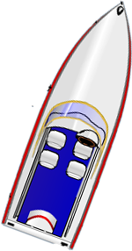
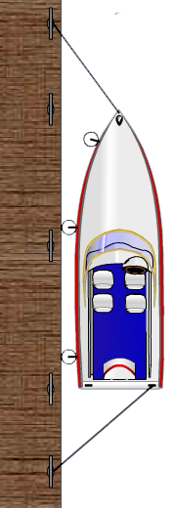
Casting Off Wind Off the Dock
wind
or
3
current
2
1
Notes:
Instructor Notes:
Ask: for a volunteer to describe casting off with wind/current off the dock.
Release lines
Push boat away
Shift into Forward and ease away

Slide 49
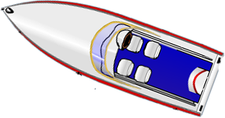
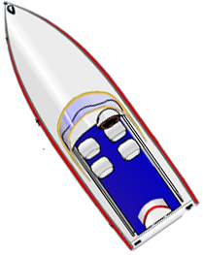
Casting Off Wind On the Dock
wind
3
or
2
current
1
Notes:
Instructor Notes: Control of a boat is from the stern with the engine – you have almost no control of the bow without thrusters
Ask: for a volunteer to describe casting off with wind/current on the dock.
Release stern line – leave bow spring line on
Put into “forward gear”
Boat stern will edge out
Release bow spring line and back out

Slide 50
Docking
As you approach the dock:
Slow down.
Wait for traffic to clear.
Get bow and stern lines ready.
Head into the wind or current—whichever is stronger.
Put boat fenders in place.
Q-12
Notes:
Instructor Notes:
Test question 12. How should you approach the dock when docking your vessel. Answer – into the wind or current, whichever is stronger.
Stand off the dock and come to a complete stop in an open area that allows maneuverability so you can judge the effect of wind or current or both on your boat and how you will need to counteract that motion to successfully dock the boat. Don’t be afraid to stop and start over as many times as needed to avoid uncontrolled motion of the boat that could result in damage to crew or the boat.
Before approaching the dock ASK-
What is the direction of the wind/current?
Are fenders out?
Are dock lines ready?
Crew ready?
SLOW approach
Remind that hands, arms legs, and feet should never be used to fend off. Use boathook!
No Wind or Current
Slow approach
Narrow angle
Step off and secure bow/stern lines
Wind or Current off the dock
Sharp angle of approach
Bow line is secured by tossing a large “loop” around dock cleat and making the line fast to the boat. Adjustments will be made later. Goal is to have bow of boat controlled by bowline to allow use of engine to bring in the stern.
Turn helm hard over towards the dock
Engine in reverse to bring stern in.
Step off and secure bow/stern lines and adjust as needed.
Wind or Current on the dock
Narrow angle becoming parallel close to the dock
Allow wind to push you on – use fenders and boat hooks – NO HANDS OR FEET!
Step off and secure bow/stern lines and adjust as needed.

Slide 51
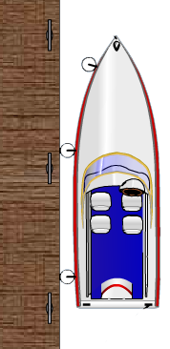
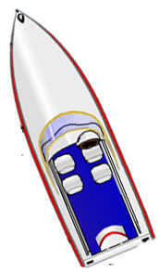
Docking with No Wind Or Current
3
2
1
Notes:
Instructor Notes:
Ask: what steps are being done here to dock the boat?
Responses:
Slow approach
Narrow angle
Step off and secure bow/stern lines

Slide 52
Docking with Wind Or Current Off the Dock
wind
or
current
3
2
1
Notes:
Instructor Notes:
Ask: for a volunteer to describe docking with wind/current off the dock.
Sharp angle of approach
Bow line is secured
Turn helm hard over towards the dock
Engine in reverse to bring stern in.

Slide 53
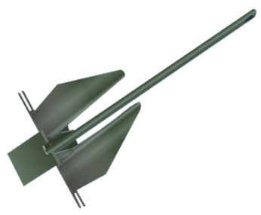
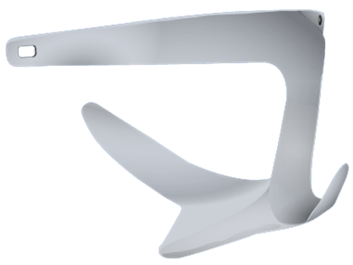
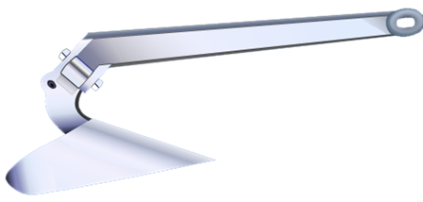
Anchors and Anchoring
Anchor Types:
Danforth
Plow
Single Fluke
Notes:
Instructor Notes:
Anchor design determines an anchor’s ability to hook the bottom.
Discuss the different characteristics of these types of anchors.
Ask: What types do the students feel are best for their boat and boating area?

Slide 54
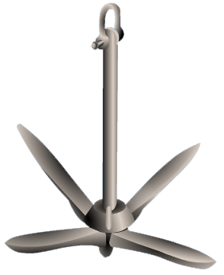
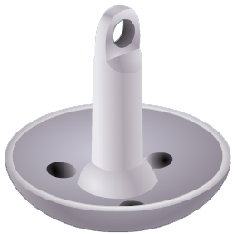
Anchors and Anchoring
Anchor Types:
Mushroom
Grapnel
Notes:
Instructor Notes:
Anchor design determines an anchor’s ability to hook the bottom.
Discuss the different characteristics of these types of anchors.
Ask: What types do the students feel are best for their boat and boating area?

Slide 55
Anchors and Anchoring
Anchoring Guidelines:
Why use chain?
What is scope?
Notes:
Instructor Notes:
Discuss the two questions:
Responses:
Chain help keeps the anchor flukes flat and allows them to dig into the bottom. It also improves chafe protection where the anchor rode touches the bottom during anchor setting.
Scope is the ratio of rode length to the depth of water.
Classroom aid: bring a small anchor and rode to demonstrate how the scope will keep the anchor flat.

Slide 56
Anchors and Anchoring
Anchoring Guidelines:
Normal scope 7:1
Calm seas 5:1
Heavy weather 10:1
Notes:
Instructor Notes:
Demonstrate how to measure rode with outstretched arms.
Ask: Why is more scope needed in heavy weather?

Slide 57
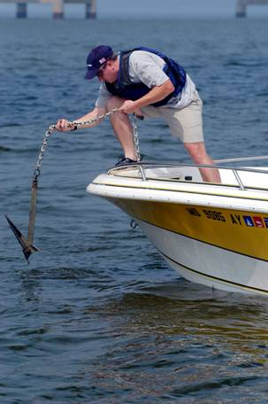
Anchors and Anchoring
Anchoring Guidelines:
Setting Anchor: What are the steps involved?
Never anchor from just the stern alone
Q-48
Notes:
Instructor Notes:
Discuss:
Bitter end of anchor rode
Select sheltered area
Approach into wind/current
Slowly lower anchor
Pay out scope while backing down
Make line fast; back down to set
Check for drift using landmarks
Test Question: What will happen if you anchor a boat from the stern? It may cause the boat to swamp.

Slide 58
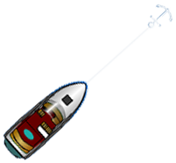
Anchors and Anchoring
Allow “Swing” Room
wind
wind
wind
Notes:
Instructor Notes:
Ask: Why is this important? Discuss proximity to other boats, taking a visual marking to the land for location, moving if someone else anchors too close to you.

Slide 59
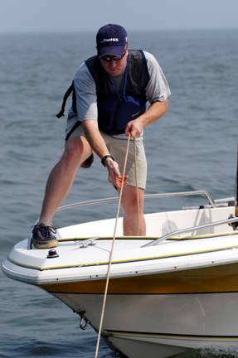
Anchors and Anchoring
Retrieving Anchor:
What are the steps?
Notes:
Instructor Notes:
Discuss:
Slowly move ahead while pulling in line.
If anchor sticks, power around in a circle.

Slide 60
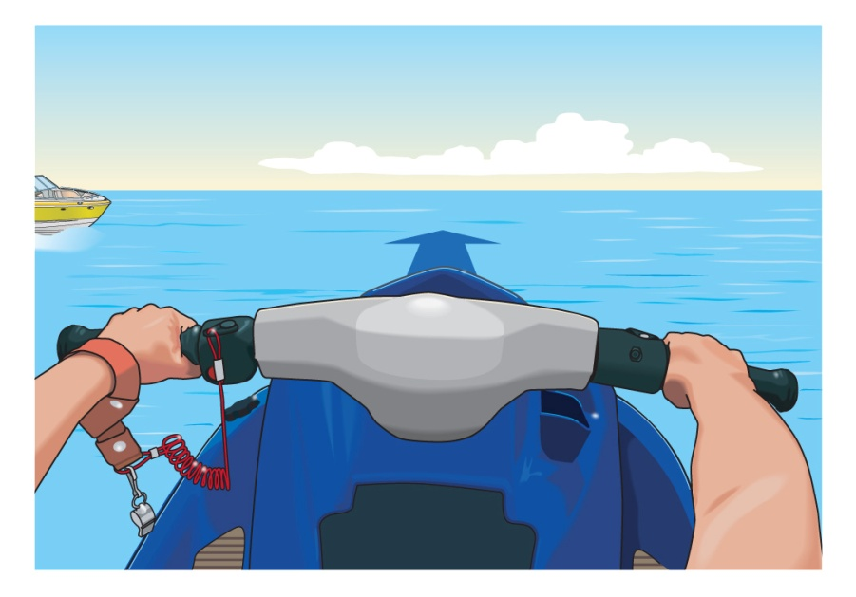
Operating a Personal Watercraft
Steering and Stopping a PWC
Most PWC (and other jet-drive vessels) must have power to maintain control.
The operator is holding down the throttle lever and steering the PWC straight ahead.
Q-37
Notes:
Instructor Notes:
Test question 37. What action may cause loss of steering ability in a PWC? Answer – Letting off the throttle control
Emphasize that without thrust from the nozzle, there is very little to zero steering control on a jet drive. Some PWCs and jet boats have rudders, but water must be moving past the rudder to change direction.
ALWAYS attach the cut off lanyard to you so when you fall off, it shuts down the engine so you can swim to it and re-board.

Slide 61
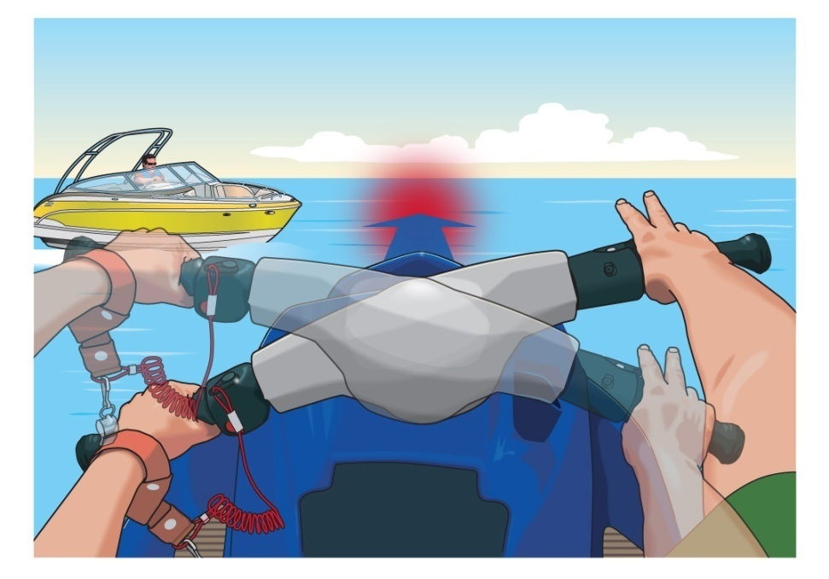
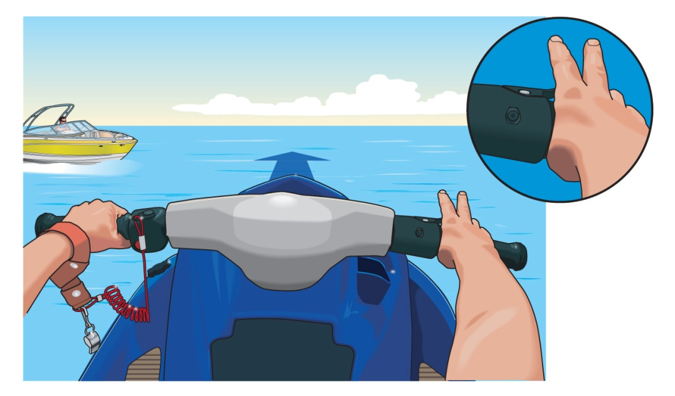
Operating a Personal Watercraft
The operator releases
the throttle lever.
The PWC may continue to go straight ahead even though the operator is trying to turn.
Newer PWC allow for off-throttle steering.
Notes:
Instructor Notes:
Try to anticipate the “way on” at various speeds and think ahead when it is time to slow down or allow the jet drive to return to idle speed. This is a skill that is only learned by experience and it is best learned in areas that are free of close quarters obstructions

Slide 62
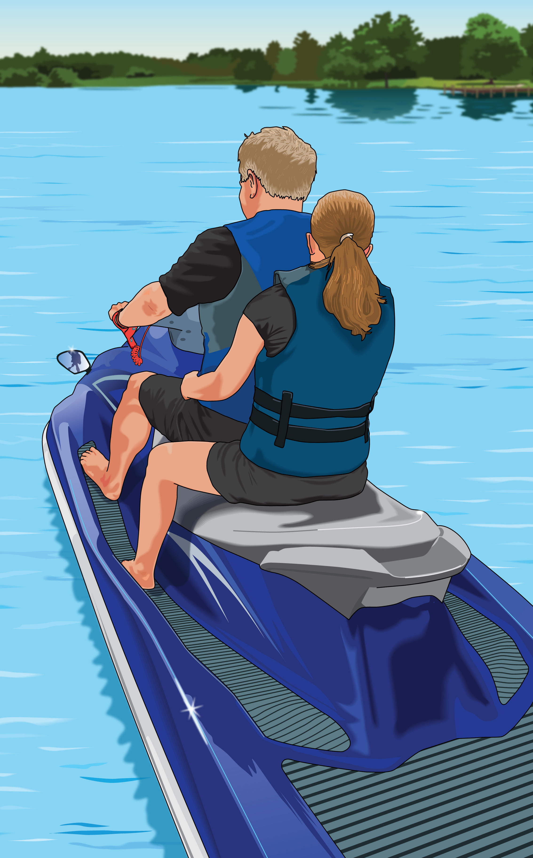
Operating a Personal Watercraft
Other PWC Considerations
Know the PWC regulations for your state.
Wear a PFD.
Make sure passenger can hold on securely.
Do not seat a passenger in front of the operator.
Notes:
Instructor Notes:
Many states have PWC specific rules. Know your state rules and discuss those that apply to PWCs

Slide 63
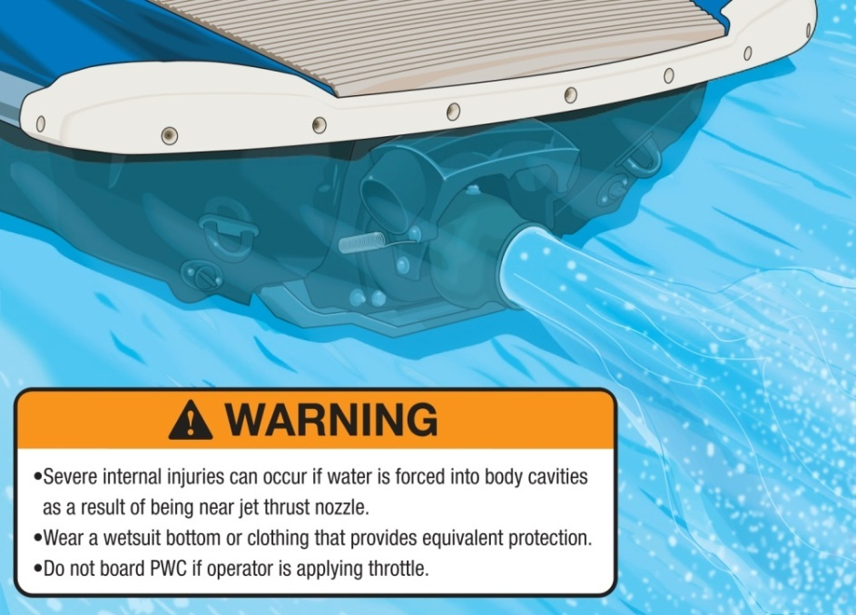
Operating a Personal Watercraft
Keep hands, feet, loose clothing, and hair away from the pump intake area.
Wear a wetsuit or clothing that provides equivalent protection.
Do not board PWC if operator is applying the throttle.
Notes:
Instructor Notes:
Don’t forget that just about anything can get sucked into the water intake including dock and tow lines, shallow water plants and rocks and anything that is in close proximity to the water intake for the impeller.

Slide 64
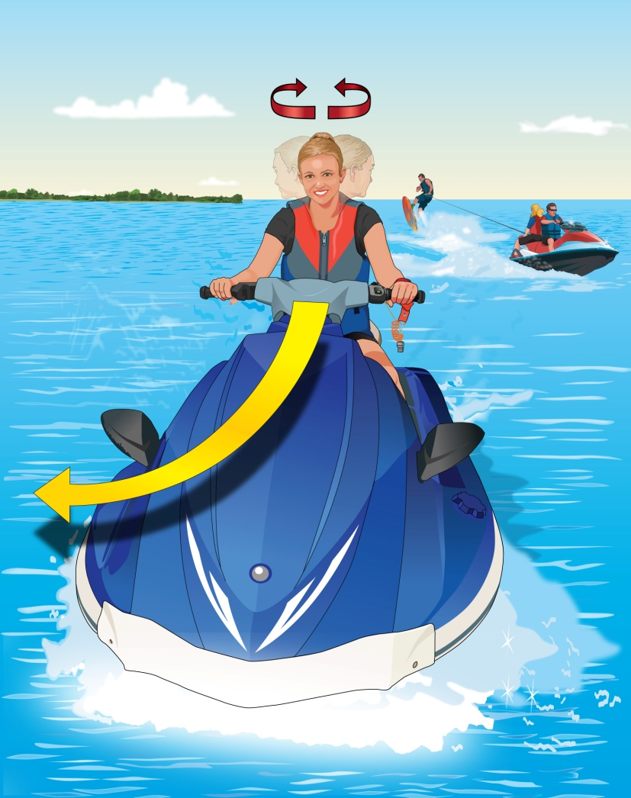
Operating a Personal Watercraft
Look over both shoulders before making turns.
Notes:
Instructor Notes:
Always have good situational awareness and look around in addition to using the mirrors. If someone is riding with you, use them to help maintain situational awareness for others coming up from behind. When riding PWCs, it is easy to get tunnel vision and focus on what is directly in front of you which excludes all other directions. You must know what is happening all around you.

Slide 65
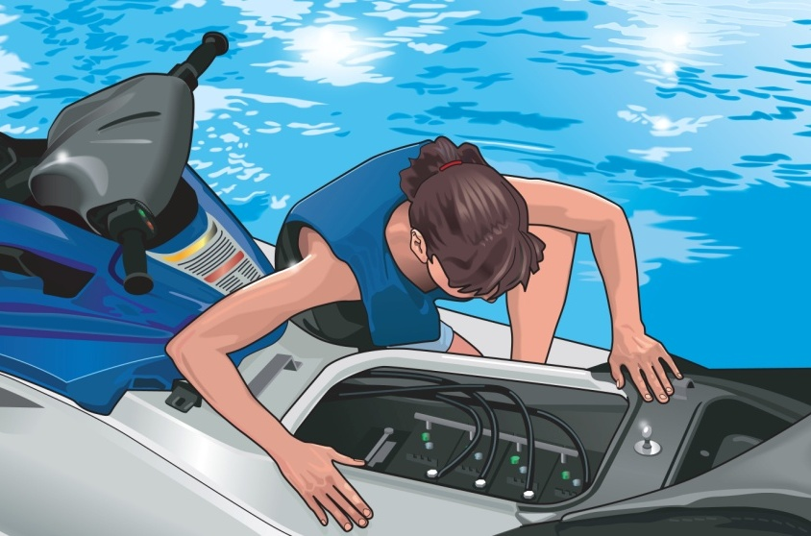
Operating a Personal Watercraft
Inspect your electrical systems and perform “sniff test” after fueling.
Avoid overloading.
Know your limits and ride according to your abilities.
Notes:
Instructor Notes:
Use your nose to check for any fuel leaks before attempting to start the PWC.
PWCs are rated for either two or three occupants. This does not mean two people on the PWC and one person being towed behind. You need one seat for each person. Many states have specific towing and capacity rules and may include restrictions, additional equipment, or special seating requirements. Know your state and local laws before teaching this chapter.
Encourage students to start out slow and easy and not to attempt high speed maneuvers or otherwise push the limits of their ability. When users exceed safe limits is when most accidents happen.

Slide 66
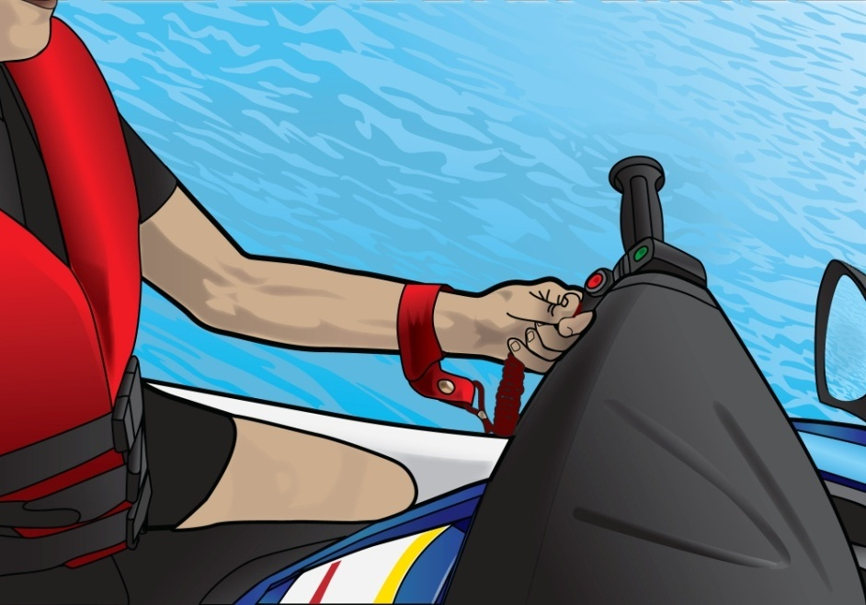
Engine Cut-Off Switches
Safety switch
Lanyard
Self-circling feature
Q-19
Q-40
Notes:
Instructor Notes:
Test Question 19. What is the main function of an engine cut off switch? Answer – To shut off the engine if the operator is thrown overboard.
Test question 40. What statement regarding PWC is true? Answer – A PWC operator is required to attach the engine cut off switch lanyard to his or her person.
Cut off switch MUST be attached and is required by law in every state.

Slide 67
Changing Water Levels
Be aware that water levels can change rapidly and cause hazards.
Running aground
Docking to a fixed pier
Learn about the tides when boating on coastal waters.
Fluctuating water levels
Strong tidal currents
Notes:
Instructor Notes:
In tidal areas – KNOW the stages of the tide and where you are in the current tide cycle. Double check depths of the water versus tide state. In certain tidal areas, what was good enough and safe water at high tide becomes exposed mud at low tide. Get local knowledge when tying up your boat to a fixed dock in a tidal area as there are several different configurations and techniques to safely tie off your boat and still allow you to get on and off with various tide conditions.
Understand the tidal forces and how this moving water affects your tie up on a dock and especially at anchor. You may need to use bigger lines or multiple anchors depending on direction and strength of the current or wind or both!
GET LOCAL KNOWEDGE WHEN IN UNFAMILIAR WATERS. If you are not sure, stop and assess the situation and then go slow!
There are several sources of tide information available on-line and most of the mapping software and apps for boating have tide information as part of the app. Become familiar with the effect and the height of the tide in the areas you are transiting.

Slide 68
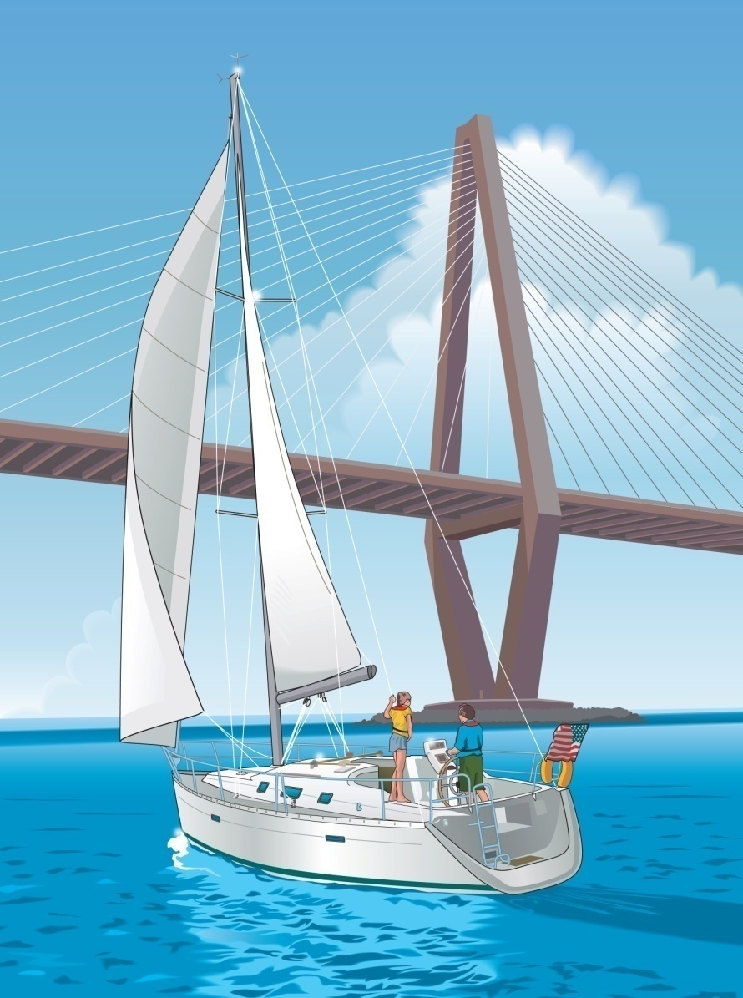
Dams, Locks, and Bridges
Bridges
Reduce speed and proceed with caution.
Check clearance before passing under a bridge.
For drawbridges, contact the bridge operator.
Watch for debris that collects around pilings.
Notes:
Instructor Notes:
Charts have bridge clearance marked. There are signboards at bridge pilings so be sure to look at the clearances to be certain you have enough vertical clearance. If you have a sailboat, it is CRITICAL that you know the clearance of any overhead power lines. The posted clearance at bridges are at “low steel” and depending on the construction of the bridge, sometimes the center of the bridge has a bit more clearance. If not certain, approach the bridge at the slowest speed possible and send a crew up top to check for clearance. Sometimes, you can lower an antenna or a Bimini top to gain enough clearance.
Drawbridges and dams usually operate on Marine VHF channel 13 and in some places 14. Charts will give the bridge information including channel or channels monitored and any time opening restrictions. Also, the Local Notice to Mariners may have additional updates for bridges and locks. This is available from the Coast Guard Navcenter and is updated weekly.

Slide 69
Avoiding Propeller Strike Injuries
Turn off the engine when:
Passengers are boarding or disembarking.
Someone is in the water near the boat.
Prevent passengers from being thrown overboard accidentally.
Never start with the engine in gear.
Never ride on the seat back, gunwale, transom, or bow.
Make sure all passengers are properly seated.
Assign someone to watch children
Q-32
Notes:
Instructor Notes:
Test question 32. What should a motorboat operator do when someone is being pulled into the boat from the water? Answer- Turn the engine off.
Always approach into the wind or the current when there is a person in the water you want to pick up. If you approach from upwind or up current, you will drift over the person in the water. By turning off the engine you eliminate any chance the propeller is turning and could do damage to the person in the water. It is ALWAYS best to have flotation (type IV) with a line attached to it you can throw to the person in the water when you get close which allows you to pull them to you instead of trying to get the boat close to them.
Every boat has an interlock that should prevent the engine stating while in gear, but use caution to be sure no one is near the propeller when the engine is started or when it is running.
Many states have rules on where to sit and what is legal. Just because riding on a gunwale or hanging your legs over the bow of the boat when underway may be legal where you boat, it is really dumb and greatly increases the odds you will be thrown overboard. If you fly out the front of the boat, you WILL get run over as it is impossible to stop the boat in time and you may get hit by the propeller. Sitting in a seat designated for that purpose is essential to safety.
Children sometimes move around unexpectedly, so use caution with small children on board and make sure they are secure anytime you need to make a quick turn that could potentially throw them around inside the boat or worse – overboard! ALL CHILDREN SHOULD BE IN LIFE JACKETS AT ALL TIMES WHEN ON DECK AND NOT IN AN ENCLOSED CABIN. Many states have specific laws regarding children and proper wear of life jackets. Regardless of what is legal, a responsible parent should NEVER allow a child not to be secured in a life jacket. Even if it is not a state rule, make it YOUR rule.

Slide 70
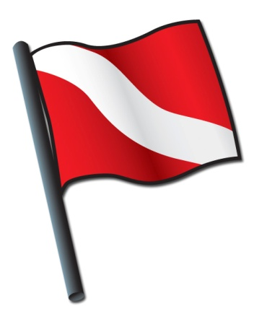
Avoiding Propeller Strike Injuries
Maintain a proper lookout for people in the water.
Slow down when approaching congested areas and anchorages.
Learn to recognize warning buoys.
Keep the boat away from marked swimming and diving areas.
Notes:
Instructor Notes:
White and blue flag is flown from a boat where diving operations are underway. Red and white flag is carried by divers in the water (on a float with line attached to them) which marks their approximate location. STAY WELL CLEAR of either flag. Some states have specific distances for separation so know your state law

Slide 71
Avoiding Propeller Strike Injuries
Devices That Reduce Propeller Strikes
Guards
Propulsion
Interlocks
Sensors
Q-15
Notes:
Instructor Notes:
Test qustion15. How can propeller strike accidents be avoided? Answer - Turn off the engine when passengers are boarding.
While propeller guards are not required on recreational vessels, propeller guards help in reducing strikes with objects in the water including people.

Slide 72
Chapter 3 Review

Slide 73
Review Exercises
What is the best way to find out about hazards on a local waterway?
Consult a nautical chart.
Consult a topographical map.
Ask someone who went there last.
d. Listen to your favorite radio station.

Slide 74
Review Exercises
How can propeller strike accidents be avoided?
Turn on the engine when passengers are boarding.
Let passengers ride on the bow while underway.
Turn off the engine when passengers are boarding.
d. Have children watch out for each other.

Slide 75
Review Exercises
What is the main function on an engine cut-off switch?
To shut off the engine if the operator is thrown overboard.
To shut off the engine when the PWC or boat is beached.
To prevent operation by unauthorized persons.
d. To prevent theft when the PWC or boat is left unattended.

Slide 76
Review Exercises
When two vessels are operating in the same general area, who is responsible for avoiding collision?
The operators of both vessels.
The operator of the stand-on vessel.
The operator of the give-way vessel.
d. The operator of the smaller vessel.

Slide 77
Review Exercises
What is indicated by a white marker with an orange crossed diamond and black lettering?
Exclusion or keep-out area, such as a dam.
Controlled area, such as a no-wake zone.
Information, such as places to find food or fuel.
d. Danger or hazard, such as rocks.

Slide 78
Review Exercises
Which action may cause the loss of steering ability in a PWC?
Running at maximum throttle.
Letting off the throttle control.
Over-steering.
d. Under-steering.

Slide 79
Review Exercises
What determines if a speed is safe for your boat?
Type of engine.
Shoreline conditions.
Visibility conditions.
d. Amount of fuel available.

Slide 80
Review Exercises
What could happen if you anchor a boat from the stern?
The anchor line may get tangled.
It may cause the boat to swamp.
The anchor can’t hold firmly.
d. The anchor is difficult to retrieve.

Slide 81
End Chapter 3

